Slide 1
Mindtree Salesforce Testing Capability Deck - Unilever
Automation Solution Options for Marketing SF DevOps project

Slide 2

Mindtree at a Glance
We engineer meaningful technology solutions to help businesses and societies flourish
$780M
Annual revenue
16,000+
Mindtree Minds
9.4%
YOY growth
Top 7
IT company in India, Fortune
70%
US
21%
Europe
9%
APAC
43
offices
17
countries
Notes:
The right hand box has center issues (both vert and horiz)
I thought we were defaulting to 16,000+ as MM scale

Slide 3


















Mindtree Testing At a Glance
Mindtree ranked as a ‘LEADER’ by
Nelson Hall Software Testing
Key Value Differentiators
Mindtree’ s Dynamic Test Engineering platform (CI) & Anytime Anywhere Solution (MAAS) - SaaS platform
Test Delivery for – End-to-end testing solution covering Digital, Mobility, Cloud and enterprise technologies
Test design and execution optimisation through the Risk-based approach
BDD, TDD driven refined test methodology addressing Agile delivery model
Specialised testing practice for Automation, Performance, Salesforce, SAP, Mobility, Data and Analytics
Jul 2016
Mindtree rated as a ‘LEADER’ in Application Testing by ISG
3200+ Test Experts
$ 144 M Annual Revenue
7 Global Test Centers
125 Active Customers
25 Fortune 500 Customers
1250+ Certified Professionals
25+ Proprietary Tools
2017
Mindtree recognised as expert in Mobile Application Testing Services by Gartner
Alliances & Partnerships
Recognitions
2017

Slide 4








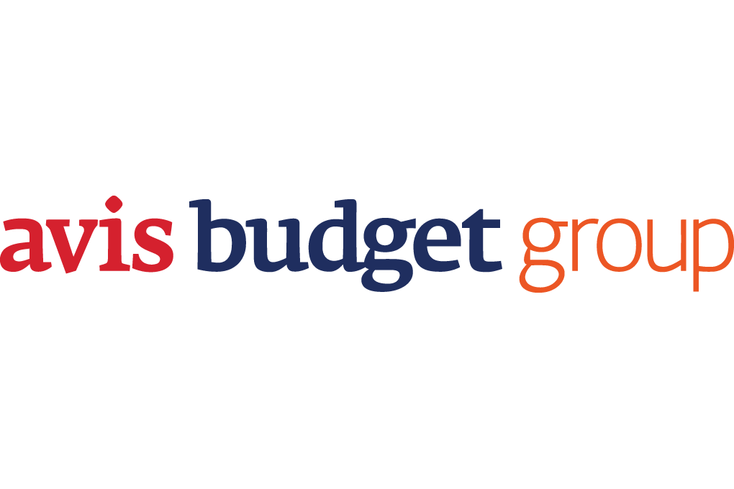








Mindtree SFDC Testing Overview
Key Facts – SFDC Testing
Our Marquee Clients
Dedicated SFDC & CRM Testing Professionals
Integrated pool of testing, domain and functional consultants
Experience in SFDC Test Consulting, Integrated & Independent Testing Services
SFDC Test Automation, Performance Test Framework & Reusable Assets
Developed Utility for SFDC – HP ALM - SAF integration
In-house SFDC Test Automation Framework built on our highly effective SAFE Framework which is actively being used across multiple customer projects
Our SFDC CoE Snap Shot
Test Tool Expertise & Partnerships
With the acquisition of Magnet 360, Mindtree adds more than 100 certified Salesforce experts
250+ Mindtree Minds (SFDC Consultants)
4 Delivery Locations servicing 300+ Active customers
360 degree relationship with salesforece.com - Platinum Cloud Alliance Partner
Methodology for Business Process Excellence and Delivery Excellence
Expert Team with Architects, Certified Developers, Business Analysts & Certified Test Consultants
Automation Testing: HP Quick Test Professional | Selenium - Java | TOSCA | Test Plant | Salesforce Automation
Performance Testing : HP Load Runner | HP Performance Centre | Rational Performance Tester | OpenSTA | Jmeter | pWatch(Mindtree Proprietary), | MobiWatch(Mindtree Proprietary)
Defect / Test Management Tools : Quality Center | ALM | Rational Quality Manager | JIRA | Bugzilla | Testlink

Slide 5
Salesforce QA Service Offerings
Sales Cloud Testing
Test Consulting
Functional Testing
Implementation Strategy
Test Process Maturity Assessment
ERP & CRM TCoE Setup
Requirements Ambiguity Testing
Functional Testing (System, Integration, Regression & UAT Support)
Risk Based Testing
New implementation
Global Rollouts
New support package implementations and localization
Service Cloud
Testing
Marketing Cloud Testing
SFDC Testing Services
Test Automation
Non-functional Testing
SFDC Mobile Automation
Tool Integration SFDC – HP ALM
Tool Integration
Salesforce & ServiceNow Automation Framework (Selenium Based)
Security (Roles) Testing
Accessibility Testing
Conversion Testing
Load/Stress Testing
Performance Testing Strategy & Plan for Implementations, Rollouts & Upgrades
Community Cloud
Chatter Testing
AppExchange
&
Force.com
Platform Testing
SFDC Expertise
Customer Relation Manager Partner Relation Management Service Management Hospitality Management Contract Mgmt.
Course Management Campaign Management Chatter Management Dealer Management Cloud craze
Exact Target Trade Promotion Mgmt. Wave Analytics

Slide 6
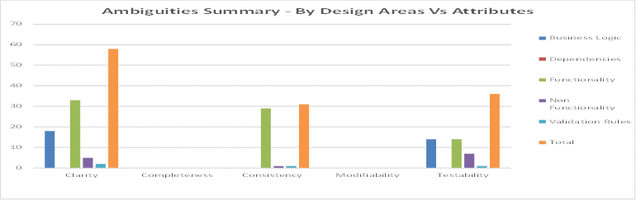
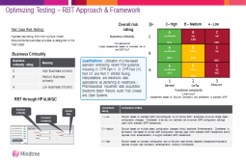

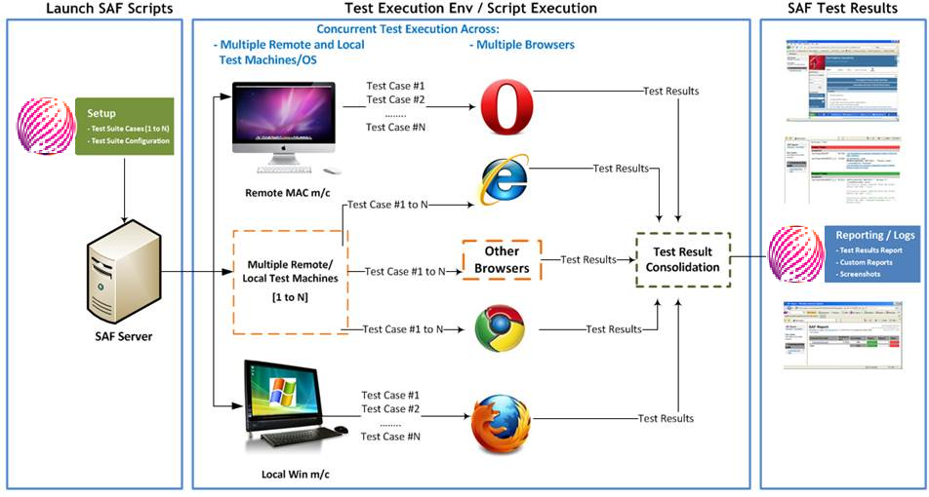
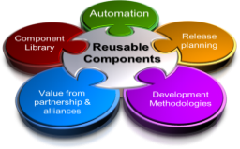
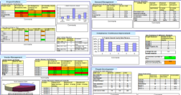
Mindtree Test Accelerators and Best Practices
Requirement Ambiguity Testing (RAT) Framework
Early Involvement of SME/ Testing Analysts & continuous monitoring for early defect detection
Reduced re-work of Design, Code and System Test resulting in lower internal failure cost
Risk Based Testing (RBT) Framework to focus on Critical User Requirements
Prioritization of tests to optimize review and execution effort
10-20% reduced testing cycle time
Ensures Maximum impact of the testing with the available resources
SFDC-Selenium Integration Automation Test Framework
Increased Test Coverage & Test Traceability
Descriptive reports (HTML) with screen exhibits
Error logs for better debugging & reduced Time to Market
Centralized Library with Re-Usable Components
Libraries of reusable components across domains and applications
Enable Business Process Testing - Reducing maintenance & design efforts
Metrics Driven Test Management For Continuous Monitoring
Quantitative Process Management program for continuous monitoring and improving process capability and product quality
Dedicated QA team assigned to work on base lining, data collection and analysis of the finalized metrics

Slide 7

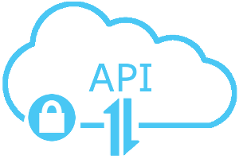

Selenium Automation CI-CD Salesforce
Selenium framework integrated with CI, Build, Source Control, SFDC Auto Deploy
Library of Reusable functions
Multiple report formats supported
Framework extensible to both development and testing teams
Excel Components
Config file
Utilities
Keyword Library
Tortoise
SVN
Jenkins
MAVEN
Drivers
Salesforce Components
Input/output file
Data Encryption for security
Reports
Excel
Html
pdf
JIRA
DB
Source Control
Jenkins CI
Maven Build
Execute Tests
Reports, Dashboards
JIRA
Email Trigger
Version Control
Check-in and Checkout
Rollback and Update
Continues Integration
Scheduling
Reporting
Build project
install Latest dependencies
POM file based builds
Execute Unit Test Cases
Execute functional tests
Executes Regression Test Suite
Report results in various formats
Send Reports to stack holders

Slide 8
SFDC CI-CD Test Automation Framework – Building Blocks
Building Blocks
Front End Web Systems
Middleware Systems
Middleware Systems
SFDC/ Force.com
Applications
SOAP, REST, Web services
Excel or CSV
Workbench, Data loader
XML
Campaign
Lead
VB Script
Accounts
Backend Systems
Configuration file
Tortoise SVN
Eclipse IDE
Contact
Jenkins
Business Rule Engine
Opportunity
Email Triggers
Workflows
Database Systems
TXT
Lead
SQL
Test Data
Front End Web Systems
Front End Web Systems
Reports
Internet Explorer
Page Library
Chrome
JAVA + Selenium
WebDriver + TestNG
HTML + LOG4J
Utilities + Assertions
JavaScript + APIs
Firefox
Utilities
Safari

Slide 9




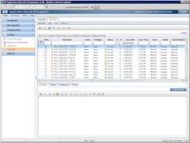



“SFDC – ALM” Adaptor
Request Received
Connector/Adaptor
Service to get Salesforce Case
Service to Create HP ALM Defect
Create New Defect
Create New
case
Case details
Request Case details
Service to update Salesforce Case
Service to get Updated HP ALM Defect
Update Defect
Data Pulling WebService
Receive Case details
Defect with SFDC Case Number
Update Case details
Scheduler
Below are the activities of this integration:
Cases (incidents) can be raised in SFDC as follows:
Customer Support manually raises Incident (by discussing details over phone with customers)
Customer can fill form and automatically incident is created in SFDC
Customer can send email and automatically incident is created in SFDC
Scheduler is designed which performs below tasks:
Incident created in SFDC will be copied in ALM with SFDC ID
Incident updated in ALM will be updated back in SFDC (Engineering team updates in ALM will be reflected back in SFDC)

Slide 10
Our Footprints
Sales Cloud
Service Cloud
Marketing Cloud
Lead Management
Contact & Accounts
PRM & Chatter
Opportunity Management
Solution Management
Knowledge Management
Social & Chatter
Case Management
Contracts Management
Campaign
Cloud Craze
Exact Target
Tools visibility
Smoke Testing
Regression Testing
Functional Testing
Exploratory Testing
Software Validation
Integration Testing
UAT Testing
Compatibility Testing
Migration Testing
Automation
Performance
Framework
Test Plan/Strategy
Artifacts
Estimation
Metrics
Best Practices
Optimized
pack

Slide 11
Our Understanding of the Requirement
Automation Feasibility
Application Feasibility to Automate
Process Standardization
Implementation of SAFE framework
Automation Coverage
Solution
Streamline QA Process
Automation Scalability
Enhance Quality Releases
Enhance Test Coverage and Reporting
Cycle Time Reduction
ROI
Automation Tool Comparison
.Tool Comparison and Evaluation
Tool Benefits and Weightage

Slide 12
Automation Implementation Approach
Salesforce Application Under Test
Due-Diligence
Planning
Develop Script
Maintenance
Application Architecture, Stability
Test Pack Analysis
Proof of Concept/Prototyping
Identify Tool
Automation Framework Design
Prioritize Test Pack
Validate the Effort Estimation
Determine Priorities
Script Integration, Reviews, Testing, Re-work
Test Scripting
Documentation
Dry Run
Test Report
Training,
Framework Documentation
User Documentation for the test scripts
R
O
I
Unreliable
Susceptable
Acceptable
Desirable
Automation Readiness
Mindtree SAFE Automation Framework
Automation Governance Automation Tool Validation
Enterprise Wide Automation Framework Proactive Automation Implementation

Slide 13
Test Automation Selection
Criteria For Selecting Candidates For Test Automation
Repeatability of a test case: The test case is part of the regression test suite executed during every SFDC release
Functional Stability: Previous defect history will indicate whether a functionality implemented using Salesforce is stable or not.
Bulky tests: High setup efforts required. For example, a lot of pre-requisite data needs to be populated to perform test
Batch execution: Group of tests to be executed sequentially to ensure core functionalities. For example: A group of transactions executed during smoke test.
Error prone functionalities: Testing is done iteratively using multiple data sets to validate a specific salesforce functionality.
ROI based approach
Optimize testing effort & cost
Reduce test cycle time
Reduce requirements for oracle EBS SME during testing
Optimize automation coverage
Release priorities
Salesforce stable functionalities
Past defects &defect propagation
Core business processes implemented using Salesforce
ROI based approach
Optimize testing effort & cost
Reduce test cycle time
Reduce requirements for QA SME during testing
ROI based approach
Optimize testing effort & cost
Reduce test cycle time
Reduce requirements for oracle EBS SME during testing
Why
What
When
How
Align to program roadmap
Regression inflection point
Oracle EBS application stability
Oracle EBS release schedules
Align to program roadmap
Regression inflection point
Salesforce application stability
Salesforce release schedules
Align to program roadmap
Regression inflection point
Oracle EBS application stability
Oracle EBS release schedules
Test automation tools & frameworks
Common framework & processes
Scripting guidelines
Test automation design
Tools support for Salesforce
Mkt Module | Transaction | Is It Stable? | Is It Repeatable | Future Usage | SME Engagement | Value | Automated?
Campaign | Load Campaign | ✓ | ✓ | ✓ | ☒ | ☒ | ✓
Responses | Track Responses | ✓ | ✓ | ✓ | ☒ | ☒ | ✓
Lead | Lead Conversion | ✓ | ✓ | ☒ | ☒ | ☒ | ☒
Opportunity | Create Oppty | ☒ | ☒ | ☒ | ✓ | ✓ | ☒

Slide 14
Testing Tools – Features & Comparison
Features | HP UFT | Selenium | Provar
Web applications support | Yes | Web bases applications can be automated with Selenium | Web bases applications can be automated with Provar
Custom Coding | Yes, UFT, VB scripting knowledge is required | Yes, Java scripting knowledge is required, can automate complex validations easily | Yes, Java scripting knowledge is required
Test Management | Yes ALM | Yes, SVN,JIRA,ALM | ALM
Tool Integration | Easy, no cost and in built adapters are available for ALM | Yes | Yes
Risk Based Testing | Yes | Yes | Yes
CI-CD | Yes | Yes | Yes
Licensing Cost | High | Free | High
Supported Language | VB Script | Selenese, Java, Ruby, Perl, PHP, Python, C#, Groovy | Java
Execution speed | Medium | High for supported apps. | High
Object Identification | UFT specific Mechanism | Xpath (universal) | Recording
Package Apps | Yes | Yes | Not complete compatablte

Slide 15
Pros and Cons using Selenium
Pros
Action Handling: All possible actions of Salesforce objects is handled(Click, Lookup)
Visual force pages, lightning Salesforce API can be easily handled
Can handle locator with dynamic values using parent child relationship
Supports Service Cloud, other packages of salesforce like cloudCrase and Third party application integration
Integrated with CICD model and can run scripts at any time any ware using Jenkins
Test Suite management and Test Data Management is done through Excel utilities
Data encryption is achieved, for hiding the details like password.
The framework is built for salesforce applications, execution speed is faster compared to other frameworks.
HTML source is used for identifying Locaters, Any browser compatibility is achieved
Java is used for scripting, this can run on any Operating system.
Report Generation is different formats.
Tools and Supporting software are Free, it is also cost effective
Cons
Scripting Knowledge is required

Slide 16
Scope Inclusion and Exclusion
In Scope
Automation Framework Development
Conversion of Feasible Manual Test cases into Automated Test cases for the Scenarios Listed SWOP
Test Execution during Test Automation Development
Support, Maintenance
Out of Scope
Performance and security testing.
Procurement of tools and licenses required for this project.
Any other tasks which is not mentioned in “In Scope” section.

Slide 17
Assumptions and Dependencies
S.No | Assumptions Description
1 | Estimations is provided based on the SAFE Framework implementation else estimations would change.
2 | Complexity (Simple : Medium : Complex) assumed is as follows : 0% : 60% : 40%
3 | Execution would be carried out on stable environment.QA,PreProd and Prod Sandbox
4 | Considering 3 Browsers for execution
5 | Test Data to be provided for Automation in the format requested
6 | Only English language is considered for automation
7 | A dedicated QA Automation Test environment is provided
8 | # Test cases considered for automation are 100% of the total test cases
9 | Esimation is done based on the Test scenarios outlined for SWOP in Complexity Definition tab
10 | No of Browser consider for execution is IE and Chrome
11 | No of test execution cosidered is QA,PreProd and Prod Sandbox
12 | SWOP is a Salesforce application without any external interfaces
13 | No of Hierarchical Roles considered for Automation 4 roles
14 | Special set of Data(To fetch data from external sources) is out of scope for estimation
15 | All the Test cases should be Functionally workig in a stable environment
16 | Manual Testing in out of scope
17 | All the dependencies related to systems, access & requirements will be available at the time of automation
18 | In the absence of all the information required, the estimations are based on these assumptions. Any change in the assumption will require the estimation revalidation

Slide 18
Project Duration And Road Map
The following tables show the resource requirement and duration/schedule (Start date and end date may change based on the actual start date and holidays, if any).
Phase | W1 | W2 | W3 | W4 | W5 | W6 | W7 | W8 | W9 | W10 | W11 | W12 | W13 | W14 | W15 | W16 | W17 | W18 | W19 | W20 | W21 | W22 | W23 | W24 | W25 | W26 | W27 | W28 | W29 | W30
KT and Analysis
JIRA Setup and installation of cucumber supported plugins (Xray)
Access Permission and User creations
Preparing Automation testplan, testsuite and Cucumber readiness
Gherkin script preparation for all the test cases which are in scope
Jenkins server and Repository setup for the CICD
Users creation and access permission
Framework customization for Unilever Project
Automation script preparation and execution
Maintenance and support
Deliverables
Automation test plan
Framework documentation
Automation test script
Automation Report
Key automation metrics
Estimates:# Person Days effort of Automation 150

Slide 19
Resource Loading
Roles | Sep |  |  |  | Oct |  |  |  |  | Nov |  |  |  | Dec
 | Analysis & KT | JIRA Setup |  | Test Planning | Gherkin Scripting |  |  | Jenkins Setup |  | Framework Cust | Automation Scripting and Execution |  |  |  | Maintanance and Support
 | W1 | W2 | W3 | W4 | W5 | W6 | W7 | W8 | W9 | W10 | W11 | W12 | W13 | W14 | W15 | W16
Test Lead | 1 | 1 | 1 | 1 | 1 | 1 | 1 | 1 | 1 | 1 | 1 | 1 | 1 | 1 | 1 | 1
Automation Tester | 1 | 1 | 1 | 1 | 1 | 1 | 1 | 1 | 1 | 1 | 1 | 1 | 1 | 1 | 1 | 1

Slide 20






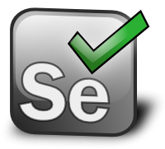

End – End Automation Approach
Scripting
Source Code Mgmt
Unit Testing
Code Quality
CSV, Excel
Java Selenium
Code Commit and Build
API & Component Validation
Code Analysis
Data Setup
Email Notification
Reports
Regression Suite
Functional Test
UI Validation Scripting
Continuous Integration and Development
Automated Testing

Slide 21
Success Stories

Slide 22

CRM Selection & Implementation to Safeguard Business Critical Data & Files
Client is one of the leading global providers of financial communications standards platform and services that enable banks & financial institutions to exchange financial information securely and reliably.
Salesforce Products:
Sales & Service Cloud
Force.com
Portals & Communities
Need a CRM to manage the leads pipeline for B2B and B2C prospects for new line of online courses
CHALLENGE
SOLUTION
BENEFITS
Customized CRM evaluation amongst SAP CRM, Siebel, MS Dynamics and Salesforce.com
Migration from multiple CRM applications to one platform - Salesforce.com
Consultation for implementation of Sales Cloud, Service Cloud, Campaign Management Solution, Customer & Partner Portal
Application to replicate Salesforce.com data on in-house Oracle DB
Implementation of Cipher Cloud (COTS Encryption Gateway) to encrypt sensitive data stored in Salesforce.com in real time
No Test strategy defined for SF or Mobile Apps.
Test team or tools not in place
No test preference – Automation vs Manual
No Regression test suite
Cost saving of 2M € over 5 year TCO
Higher operational efficiency and customer satisfaction
Single CRM platform leading to reduced turnaround time for new features
Business continuity and secure data residency
Met security and regulatory requirements by achieving on-premise file storage in a cloud based solution

Slide 23

AdManager
Developed and tested the application integrated with SFDC and replacing the existing legacy systems
Deliver optimal performance and improved time to market
CHALLENGE
BENEFITS
SOLUTION
Centrally Managed application for all Advertising production activities.
Single Sign-On Implemented.
Ease of use and Intuitive.
Scalable to support multiple languages if need be.
It is a collaboration tool for all the Advertising Production activities.
Efficient and consistent testing ensured high quality of deliverables.
Historically customer did not have a central record of any of their advertising production activity, including TV/Cinema, Print, Radio, Digital, internal comms video production and language adaptations..
AdManager was introduced as an online tool to help customer track production activity, production spend and which suppliers we were using and where.
Develop Test Execution report Dashboard.
Integration testing with multiple modules.
Savings calculation based on the products.
Generating reports and dashboards with different combinations.
UI design.

Slide 25
Features of Selenium
Cost Effective
Selenium is an open source tool freely available
Complex Scenarios
Framework allows us to measure time taken for page load, navigation and each action on the page Such as button clicks timings. This can then be used to provide a bench mark to set the performance SLA’s
All custom function,popups and Iframes can be handled
Emails testing / Notifications
Framework has built it capability to trigger email notification with the execution report to intended stakeholders
HTML and Excel output Reports
Framework has the capability to generate HTML report with different charts and drill down steps with screen shots (If needed)
Excel outputs with the record Id created for the given test data else the failure reason
API testing
Framework has builtin capability to test SFDC API’s and custom API’s directly.
Bulk Testing
Framework provides an option to load data in Bulk. Data is can be held in csv or excel files and fired at the application to make sure that data is upload or updated correctly and that SFDC limits are not breached
Testing on different environments
Framework has the capability to adopt to different sandboxes by just changing the Sandbox name in the Config File.
Script Development and maintenance
Scripts can be developed by and end user and with minimal coding experience using the built functions available in the framework.
Waiting for action to complete
Framework has synchronization features without using explicit wait (thread.sleep)

Slide 26
Limitations of Provar
Maximum of 50 records can be handled in one instance
Provar does not allow file upload or download popups
Dynamics locator will not update on changing element attribute
Java is Coding Language used in Provar for adding custom functions

